Slide 1
Data Engineering 1 Term project 2
Team Manila:
Haaris Cheema
Muhammad Talha Zahid
Peter Endes-Nagy
Sabina Umarova

Slide 2
Executive summary
Research question:
Exploring the relationship between suicides rates and the GDP per capita as well as the unemployment rate in a country
Extraction of data from two sources:
1) World Health Organisation
2) World Development Indicators
Utilization of 3 methods:
1. MySQL
2. R
3. API in Knime
Results:
1. Correlation
2. Regressions
3. Scatterplots

Slide 3
MySQL – Suicides data
Downloaded suicides data from World Health Organisation
Transformed data into .SQL format with Freeware software
Created table Suicides
Dropped unnecessary columns
Exported data into Knime using MySQL connector node

Slide 4
World Bank API – URL Breakdown
scheme
version of the indicators API
Indicators
(GDP, unemployment, population)
format (JSON)
http://api.worldbank.org/v2/country/all/indicator/NY.GDP.PCAP.CD;SL.UEM.TOTL.ZS;SP.POP.TOTL?source=2&format=json&date=2010:2019
domain
countries (all)
dataset source
date range

Slide 5
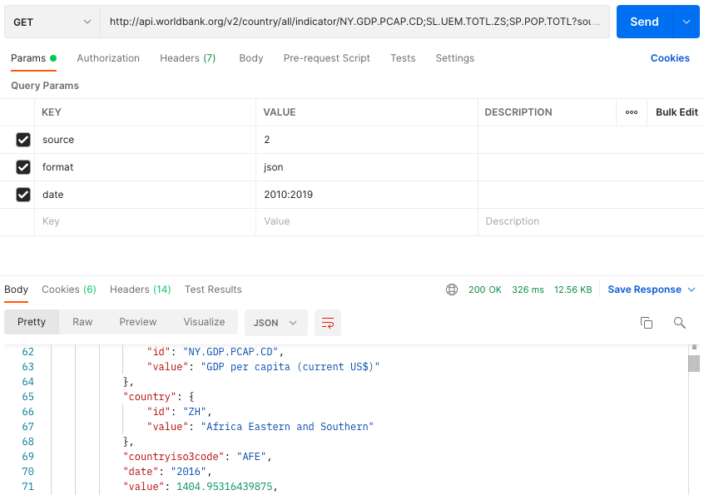
World Bank API – Postman Result

Slide 6
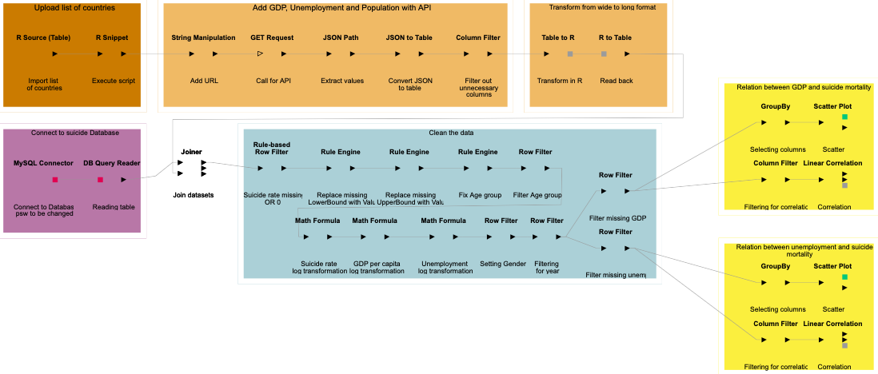
Knime Workflow

Slide 7
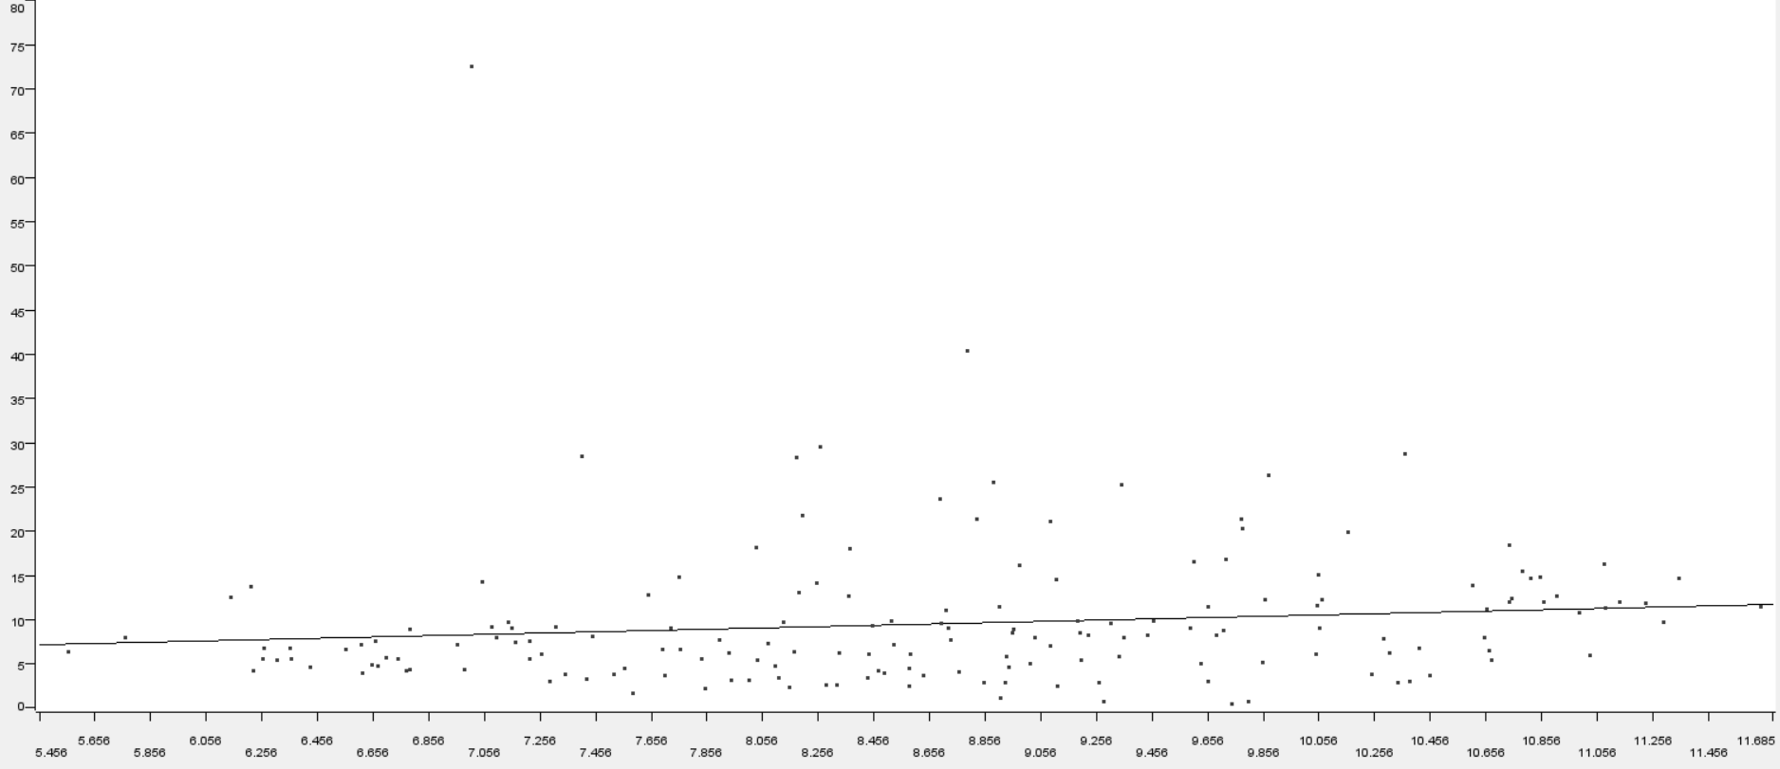
Regressing GDP per capita against suicide mortality
Log – Level Regression (Regress suicide rate on GDP per capita) [R-Squared: 0.0163]
Variable | Coefficient | Standard Error | t - value | p - value
log_GDP | 0.73 | 0.44 | 1.67 | 0.096
Intercept | 3.21 | 3.85 | 0.83 | 0.406

Slide 8
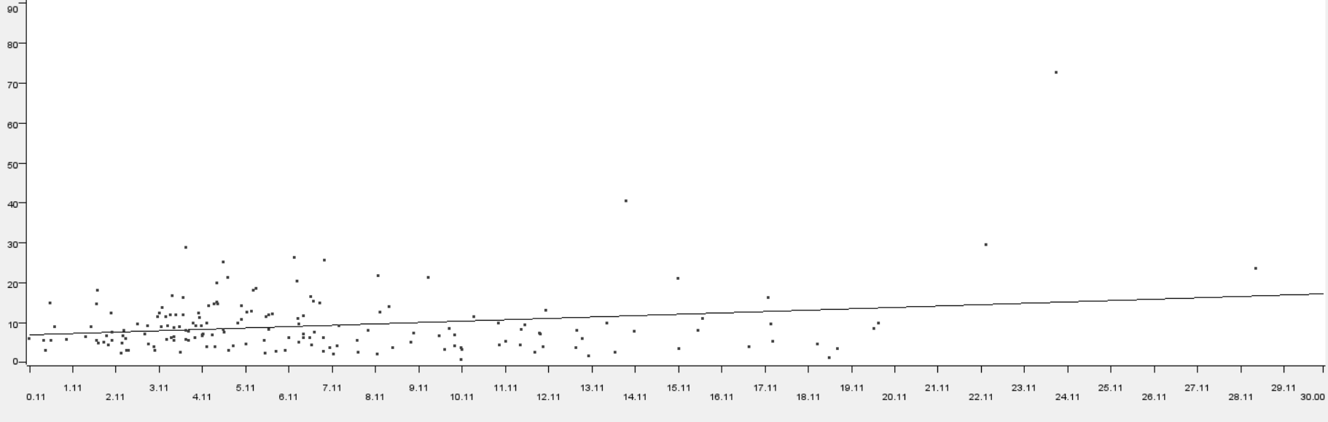
Regressing unemployment rate against suicide mortality
Level – Level Regression (Regress suicide rate on unemployment rate) [R-squared : 0.0505]
Variable | Coefficient | Standard Error | t - value | p - value
Unemployment | 0.35 | 0.12 | 3.01 | 0.003
Intercept | 6.92 | 0.99 | 6.99 | 6.023581633485264E-11

Slide 9
Any Questions?

